Slide 1
Heap and Heapsort

Slide 2
Why study Heapsort?
It is a well-known, traditional sorting algorithm you will be expected to know
Heapsort is always O(n log n)
  Quicksort is usually O(n log n) but in the worst case slows to O(n²)
  Quicksort is generally faster, but Heapsort is better in time-critical applications
Heapsort is a really cool algorithm!

Slide 3
What is a “heap”?
Definitions of heap:
  A large area of memory from which the programmer can allocate blocks as needed, and deallocate them (or allow them to be garbage collected) when no longer needed
  A balanced, left-justified binary tree in which no node has a value greater than the value in its parent
These two definitions have little in common
Heapsort uses the second definition

Slide 4
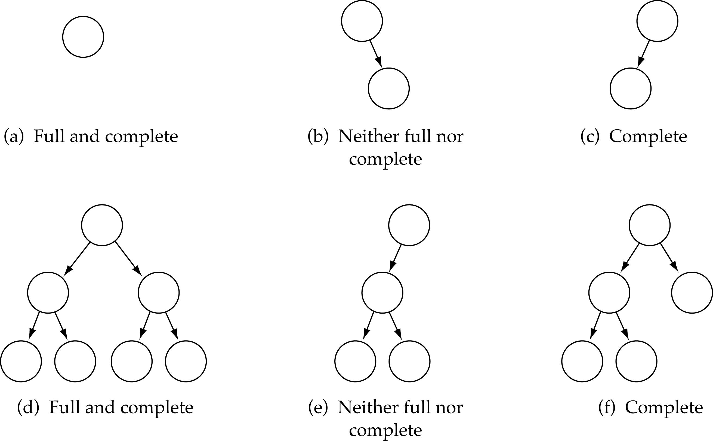
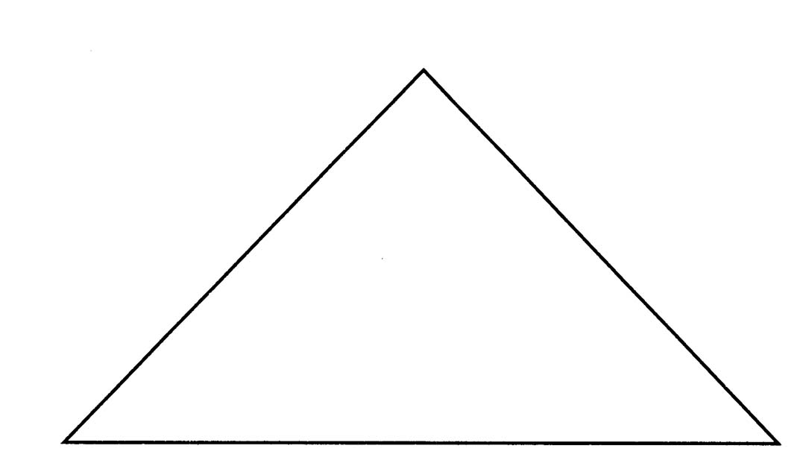
Full Binary Tree
Every non-leaf node has two children
Leaves are on the same level
Full Binary Tree

Slide 5
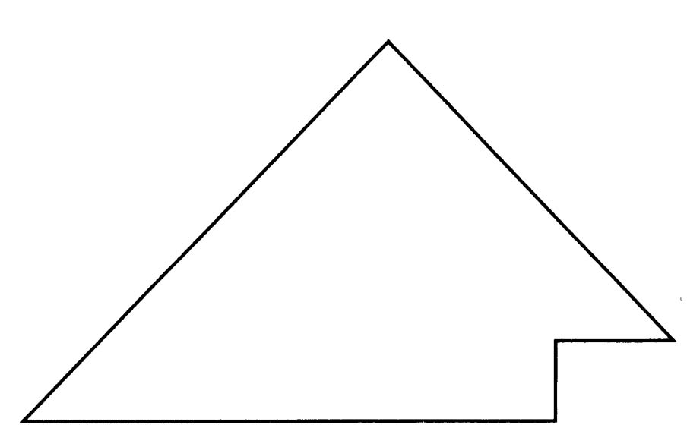
Complete Binary Tree
(1) A binary tree that is either full or full through the next-to-last level
(2) The last level is full from left to right (i.e., leaves are as far to the left as possible)
Complete Binary Tree

Slide 6
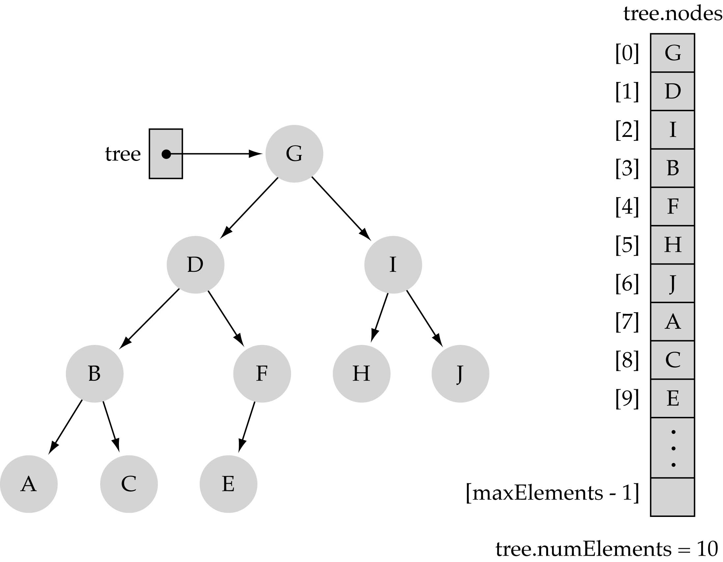
Array-based representation of binary trees
Memory savings (i.e., no pointers)
Preserve parent-child relationships
Store: (i) level by level, and (ii) left to right
0
1
2
4
5
6
3
7
8
9

Slide 7
Array-based representation of binary trees (cont.)
Parent-child relationships:
  left child of tree.nodes[index] = tree.nodes[2*index+1]
  right child of tree.nodes[index] = tree.nodes[2*index+2]
  parent node of tree.nodes[index] = tree.nodes[(index-1)/2]
  (int division)

Slide 8
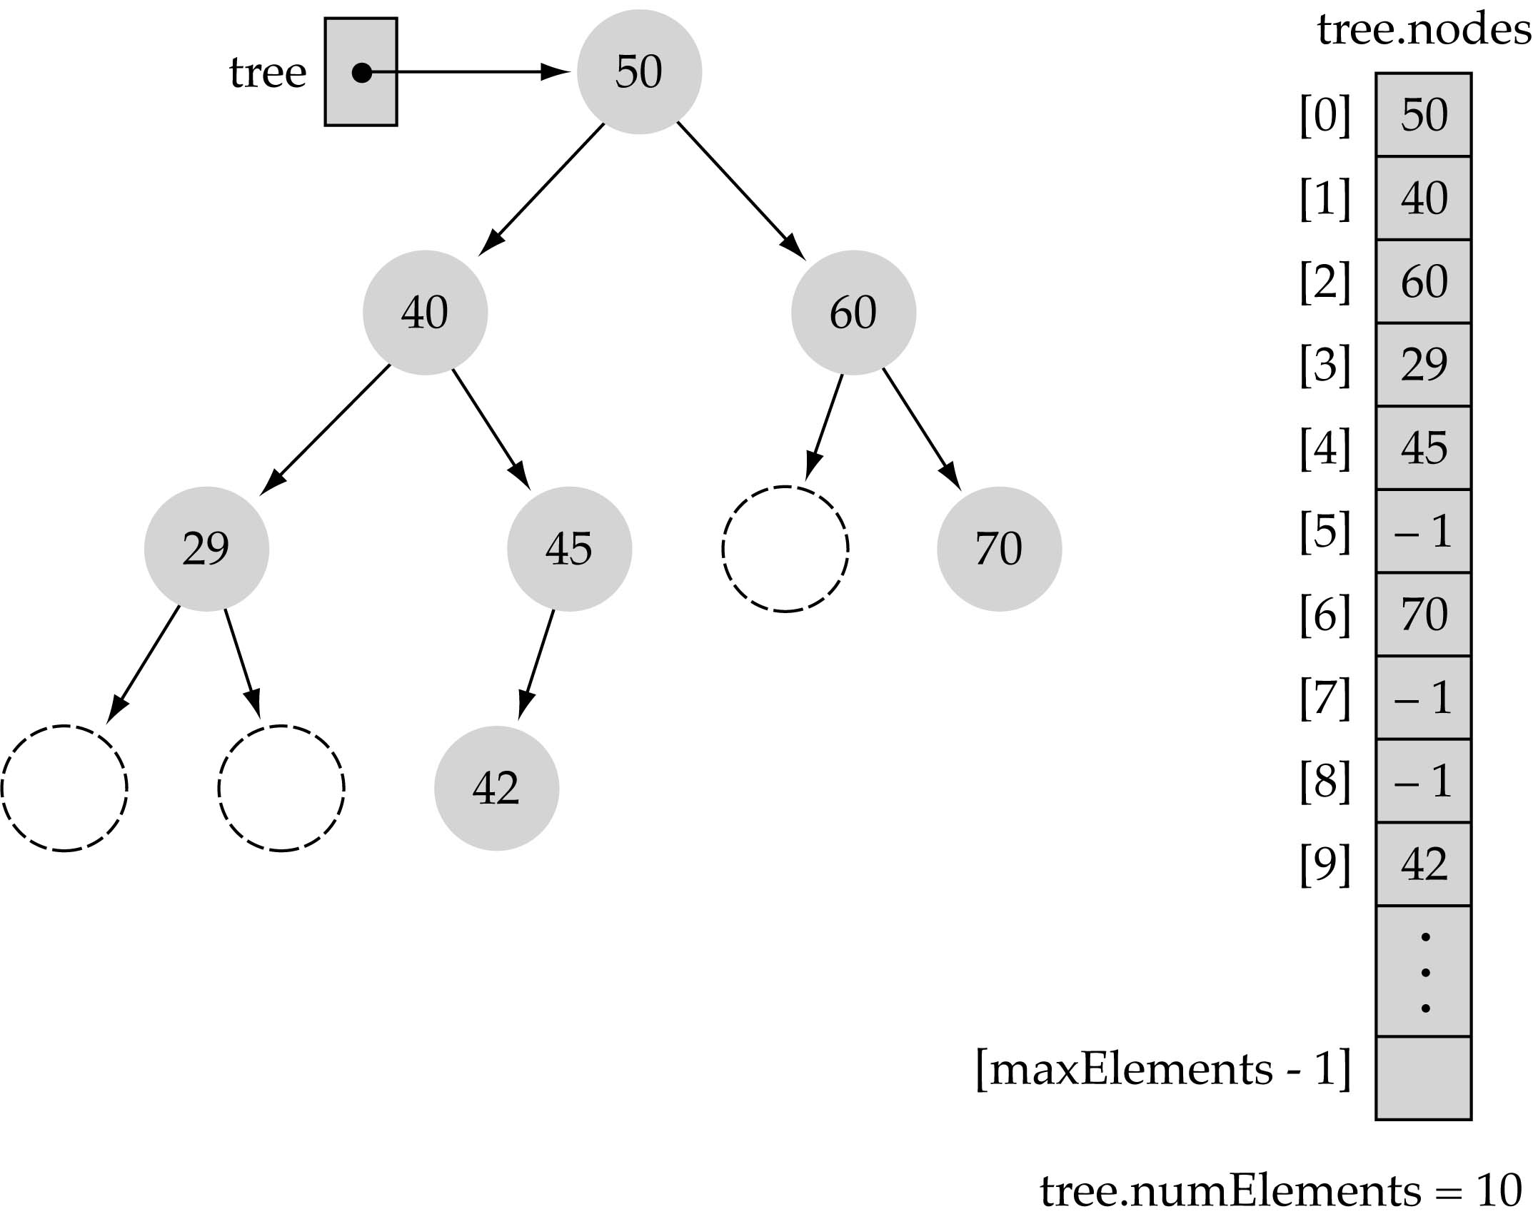
Array-based representation of binary trees (cont.)
Full or complete trees can be implemented efficiently using an array-based representation (i.e., elements occupy contiguous array slots).
“Dummy nodes" are
required for trees which
are not full or complete.

Slide 9
What is a heap?
It is a binary tree with the following properties:
  Property 1: it is a complete binary tree
  Property 2: (heap property): the value stored at a node is greater or equal to the values stored at the children

Slide 10
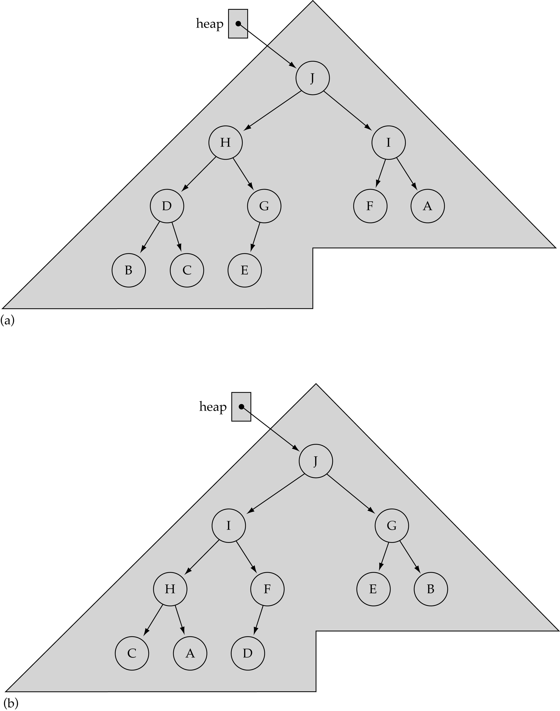
Not unique!

Slide 11
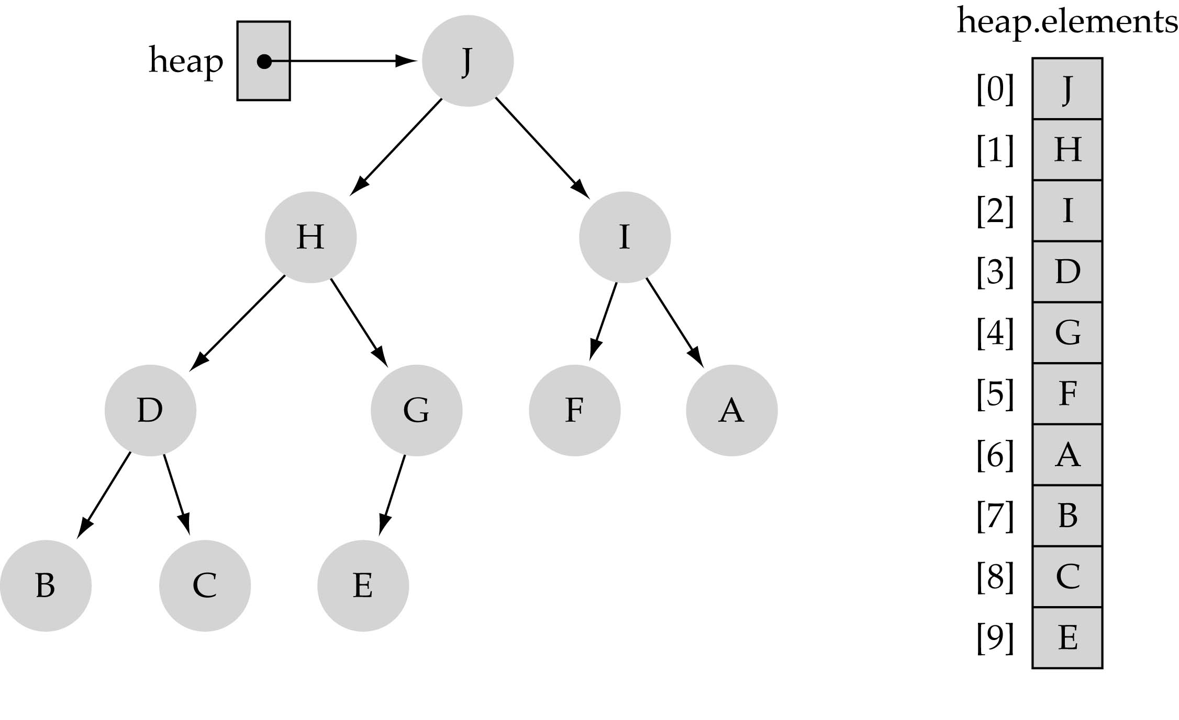
Largest heap element
From Property 2, the largest value of the heap is always stored at the root

Slide 12
Heap implementation
Heaps are always implemented as arrays!

Slide 13
Balanced binary trees
Recall:
  The depth of a node is its distance from the root
  The depth of a tree is the depth of the deepest node
A binary tree of depth n is balanced if all the nodes at depths 0 through n-1 have two children
n
Balanced
Balanced
Not balanced

Slide 14
Left-justified binary trees
A balanced binary tree of depth n is left-justified if:
  it has 2^{n} nodes at depth n (the tree is “full”), or
  it has 2^{k} nodes at depth k, for all k < n, and all the leaves at depth n are as far left as possible
Left-justified
Not left-justified

Slide 15
Plan of attack
First, we will learn how to turn a binary tree into a heap
Next, we will learn how to turn a binary tree back into a heap after it has been changed in a certain way
Finally (this is the cool part) we will see how to use these ideas to sort an array

Slide 16
The heap property
A node has the heap property if the value in the node is as large as or larger than the values in its children
12
12
12
8
3
8
12
8
14
Blue node has heap property
Blue node has heap property
Blue node does not have heap property
All leaf nodes automatically have the heap property
A binary tree is a heap if all nodes in it have the heap property

Slide 17
Reheap
Given a node that does not have the heap property, you can give it the heap property by exchanging its value with the value of the larger child
12
14
8
14
8
12
Blue node does not have heap property
Blue node has heap property
This is sometimes called sifting up/percolate up.
Notice that the child may have lost the heap property

Slide 18
Constructing a heap I
A tree consisting of a single node is automatically a heap
We construct a heap by adding nodes one at a time:
  Add the node just to the right of the rightmost node in the deepest level
  If the deepest level is full, start a new level
Examples:
Add a new node here
Add a new node here

Slide 19
Constructing a heap II
Each time we add a node, we may destroy the heap property of its parent node
To fix this, we use reheap.
We repeat the reheap process, moving up in the tree, until either
  We reach nodes whose values don’t need to be swapped (because the parent is still larger than both children), or
  We reach the root

Slide 20
Constructing a heap III
8
8
10
10
10
8
8
5
1
2
3
10
10
12
8
5
12
5
10
5
12
8
8
4

Slide 21
Other children are not affected
12
12
14
10
5
14
5
12
5
8
14
8
10
8
10
The node containing 8 is not affected because its parent gets larger, not smaller
The node containing 5 is not affected because its parent gets larger, not smaller
The node containing 8 is still not affected because, although its parent got smaller, its parent is still greater than it was originally

Slide 22
Heap implementation
Heaps are always implemented as arrays!

Slide 23
Building a Heap
Place N keys in an array(unsorted)
The Following algorithm will build a heap out of N keys.
Build heap
Heapsize[A]← length[A]
// transform array a[ ], containing n items, into a heap
for( int i = n-1/2; i >= 0; i – – )
{
// transform a semiheap with the given root into a heap
reHeap( A[], i, n );
}

Slide 24
Why n/2?
If working from the leaf nodes, then when we're done at depth d, we know that everything below there is a heap — and that's all we need for percolations from the upper levels to work!

Slide 25
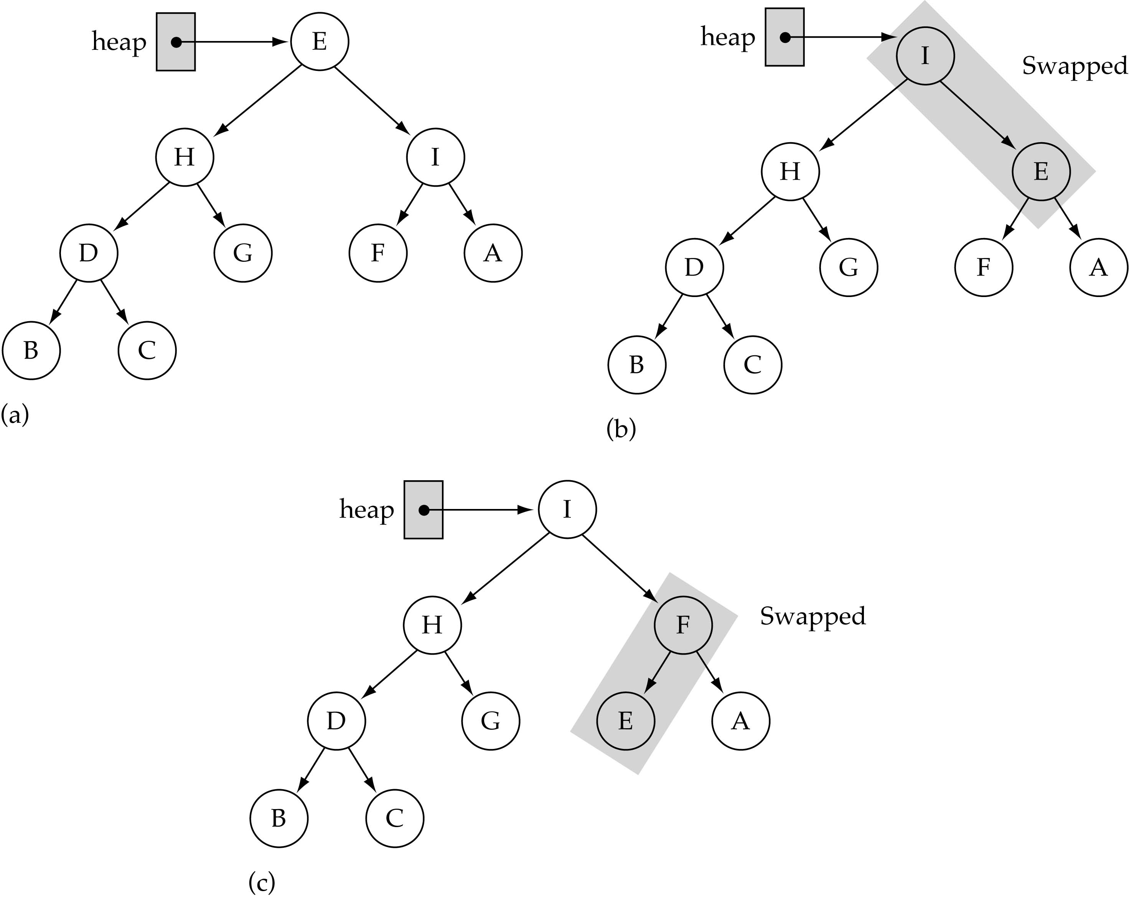
The Reheap function
Assumption:
heap property is
violated at the
root of the tree
bottom

Slide 26
Reheap(maxheapify)
void reHeap(int a[], int i, int heapsize)
{
int l, r, largest, temp;
l = 2*i+1;
r = 2*i + 2;
if(l <= heapsize && a[l] > a[i])
largest = l;
else largest = I;
if( r <= heapsize && a[r] > a[largest])
largest = r;
if(largest != i)
{
temp = a[i];
a[i] = a[largest];
a[largest] = temp;
reHeap(a, largest, heapsize);
}

Slide 27
Insertion in Heap
Step 1 − Create a new node at the end of heap.
Step 2 − Assign new value to the node.
Step 3 − Compare the value of this child node with its parent.
Step 4 − If value of parent is less than child, then swap them.
Step 5 − Repeat step 3 & 4 until Heap property holds.

Slide 28
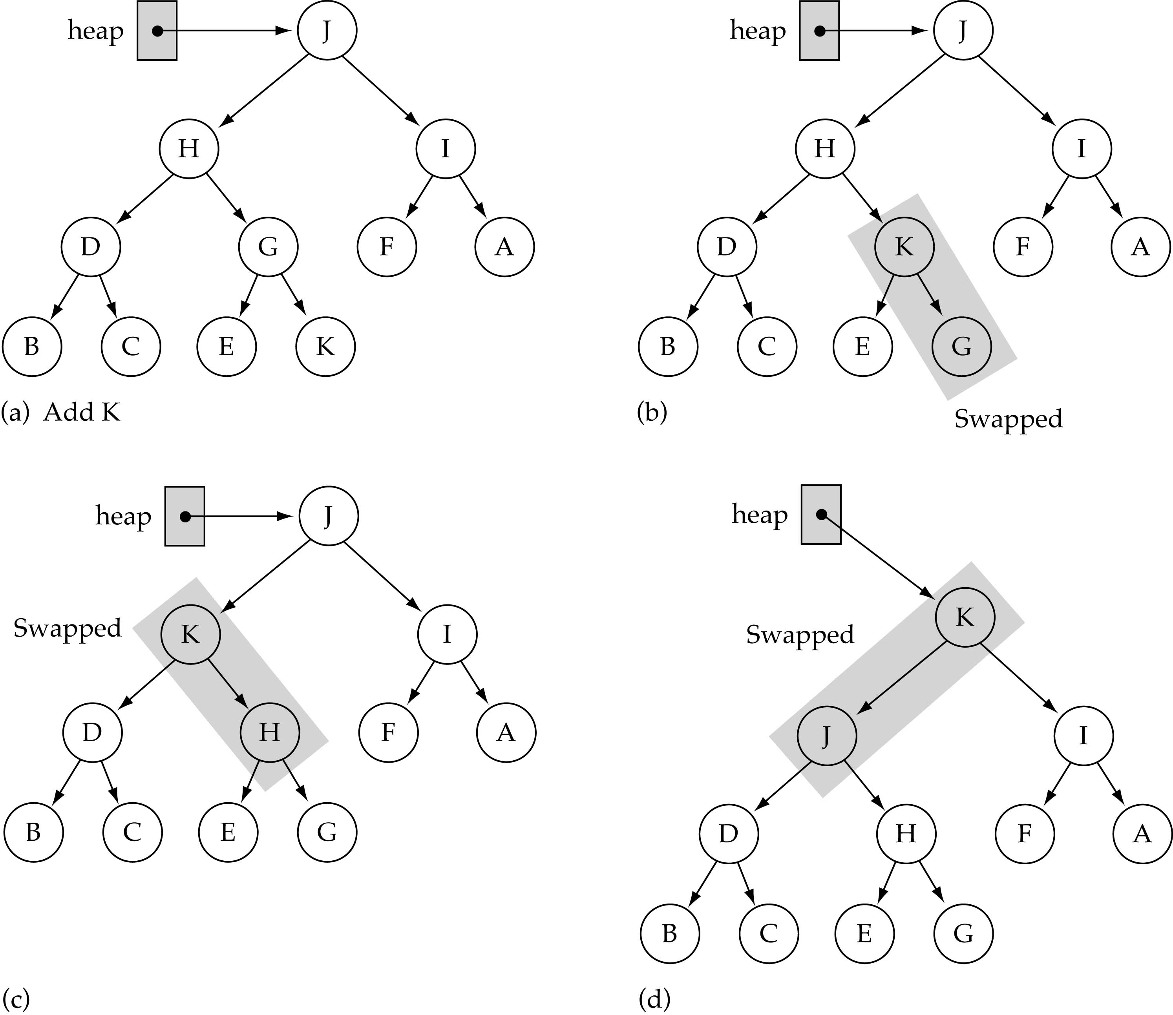
The ReheapUp function
bottom
bottom
Assumption:
heap property is
violated at the
rightmost node
of the last level
of the tree
bottom

Slide 29
ReheapUp function
rightmost node
at the last level
ReheapUp(int node index)
{
int parent, tmp;
if (nodeIndex != 0) {
parent = (nodeIndex-1)/2;
if (element[parent] > element[nodeIndex])
{
tmp = element[parent];
element[parent] = element[nodeIndex];
data[nodeIndex] = tmp;
ReheapUp(parent);
}
}
}

Slide 30
A sample heap
Here’s a sample binary tree after it has been heapified
25
22
17
19
22
14
15
18
14
21
3
9
11
Notice that heapified does not mean sorted
Heapifying does not change the shape of the binary tree; this binary tree is balanced and left-justified because it started out that way

Slide 31
Removing the root (animated)
Notice that the largest number is now in the root
Suppose we discard the root:
11
22
17
19
22
14
15
18
14
21
3
9
11
How can we fix the binary tree so it is once again balanced and left-justified?
Solution: remove the rightmost leaf at the deepest level and use it for the new root

Slide 32
The reHeap method I
Our tree is balanced and left-justified, but no longer a heap
However, only the root lacks the heap property
11
22
17
19
22
14
15
18
14
21
3
9
We can reHeap the root
After doing this, one and only one of its children may have lost the heap property

Slide 33
The reHeap method II
Now the left child of the root (still the number 11) lacks the heap property
22
11
17
19
22
14
15
18
14
21
3
9
We can reHeap this node
After doing this, one and only one of its children may have lost the heap property

Slide 34
The reHeap method III
Now the right child of the left child of the root (still the number 11) lacks the heap property:
22
22
17
19
11
14
15
18
14
21
3
9
We can Reheap this node
After doing this, one and only one of its children may have lost the heap property —but it doesn’t, because it’s a leaf

Slide 35
The reHeap method IV
Our tree is once again a heap, because every node in it has the heap property
22
22
17
19
21
14
15
18
14
11
3
9
Once again, the largest (or a largest) value is in the root
We can repeat this process until the tree becomes empty
This produces a sequence of values in order largest to smallest

Slide 36
Sorting
What do heaps have to do with sorting an array?
Here’s the neat part:
  Because the binary tree is balanced and left justified, it can be represented as an array
    Danger Will Robinson: This representation works well only with balanced, left-justified binary trees
  All our operations on binary trees can be represented as operations on arrays
  To sort:
    heapify the array;
    while the array isn’t empty {
    remove and replace the root;
    reheap the new root node;
    }

Slide 37
Mapping into an array
25
22
17
19
22
14
15
18
14
21
3
9
11
0 1 2 3 4 5 6 7 8 9 10 11 12
25
22
17
19
22
14
15
18
14
21
3
9
11
Notice:
  The left child of index i is at index 2*i+1
  The right child of index i is at index 2*i+2
  Example: the children of node 3 (19) are 7 (18) and 8 (14)

Slide 38
Removing and replacing the root
The “root” is the first element in the array
The “rightmost node at the deepest level” is the last element
Swap them...
0 1 2 3 4 5 6 7 8 9 10 11 12
25
22
17
19
22
14
15
18
14
21
3
9
11
0 1 2 3 4 5 6 7 8 9 10 11 12
11
22
17
19
22
14
15
18
14
21
3
9
25
...And pretend that the last element in the array no longer exists—that is, the “last index” is 11 (containing the value 9)

Slide 39
Reheap and repeat
Reheap the root node (index 0, containing 11)...
0 1 2 3 4 5 6 7 8 9 10 11 12
11
22
17
19
22
14
15
18
14
21
3
9
25
0 1 2 3 4 5 6 7 8 9 10 11 12
22
22
17
19
21
14
15
18
14
11
3
9
25
0 1 2 3 4 5 6 7 8 9 10 11 12
9
22
17
19
22
14
15
18
14
21
3
22
25
...And again, remove and replace the root node
Remember, though, that the “last” array index is changed
Repeat until the last becomes first, and the array is sorted!

Slide 40
Analysis I
Here’s how the algorithm starts:
    heapify the array;
Heapifying the array: we add each of n nodes
  Each node has to be sifted up, possibly as far as the root
    Since the binary tree is perfectly balanced, sifting up a single node takes O(log n) time
  Since we do this n times, heapifying takes n*O(log n) time, that is, O(n log n) time

Slide 41
Analysis II
Here’s the rest of the algorithm:
    while the array isn’t empty {
    remove and replace the root;
    reheap the new root node;
    }
We do the while loop n times (actually, n-1 times), because we remove one of the n nodes each time
Removing and replacing the root takes O(1) time
Therefore, the total time is n times however long it takes the reheap method

Slide 42
Analysis III
To reheap the root node, we have to follow one path from the root to a leaf node (and we might stop before we reach a leaf)
The binary tree is perfectly balanced
Therefore, this path is O(log n) long
  And we only do O(1) operations at each node
  Therefore, reheaping takes O(log n) times
Since we reheap inside a while loop that we do n times, the total time for the while loop is n*O(log n), or O(n log n)

Slide 43
Analysis IV
Here’s the algorithm again:
    heapify the array;
    while the array isn’t empty {
    remove and replace the root;
    reheap the new root node;
    }
We have seen that heapifying takes O(n log n) time
The while loop takes O(n log n) time
The total time is therefore O(n log n) + O(n log n)
This is the same as O(n log n) time

Slide 44
“Weakly Ordered”
We know how a binary search tree is developed – with lesser keys to the left; greater keys to the right as we descend.
  Because of this, we have nice, neat algorithms for binary search trees.
Here: No Strong Ordering:
  But for nodes in a heap, we don’t have this strong ordering - and this can cause us some difficulty.
Cannot assert much:
  We can only assert as one descends in the heap, nodes will be in descending order
  Equivalently, nodes below a node are <= the parent node.
Weakly-ordered:
  Heaps are thus said to be weakly ordered…

Slide 45
Weakly Ordered – More
No Convenient Search Mechanism:
  Because of weak ordering, there is no convenient searching for a specified key as we have in binary search trees.
  Don’t have enough info at a node to decide whether to descend left or right.
Delete:
  So to delete a node with a specific key there are issues
  No real slick way to find it.
Randomness:
  So, a heap’s organization approaches ‘randomness.’
Sufficient Ordering: Yet, there is ‘sufficient ordering’ to allow
  quick removal (yes, a delete) of the maximum node and
  fast insertion of new nodes.
➔ As it turns out, these are the only operations one needs in using a heap as a priority queue.

Slide 46
Insert / Delete – a ‘little bit’ of Implementation
While some implementations actually do the swap, there’s a lot of overhead here for a large heap.
A gain in efficiency is acquired if we substitute a ‘copy’ for a ‘swap.’ (like the selection sort…)
Here, we copy the node to be trickled to a temp area and just do compares and copies (moves) until the right spot is found. Then we can copy (move) the node (temp) (to be trickled down) into that node location.
More efficient than doing swaps repeatedly.

Slide 47
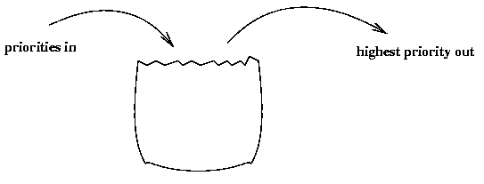
Priority Queue

Slide 48
A priority queue is different from a "normal" queue, because instead of being a "first-in-first-out" data structure, values come out in order by priority. A priority queue might be used, for example, to handle the jobs sent to the Computer Science Department's printer: Jobs sent by the department chair should be printed first, then jobs sent by professors, then those sent by graduate students, and finally those sent by undergraduates. The values put into the priority queue would be the priority of the sender (e.g., using 4 for the chair, 3 for professors, 2 for grad students, and 1 for undergrads), and the associated information would be the document to print. Each time the printer is free, the job with the highest priority would be removed from the print queue, and printed.

Slide 49
Priority Queue
Priority queues are useful for any application that involves processing elements based on some priority. It supports two major operations insert(object) and deleteMin(). The elements of a priority queue must be comparable to each other, either through the Comparable or Comparator interfaces. Using a heap to implement a priority queue, we will always have the element of highest priority in the root node of the heap. The reason to implement a priority queue is to improve its efficiency. When we implemented a priority queue with an array or a linked list, the efficiency of some operations were O(n).

Slide 50
A priority queue is a data structure that stores priorities (comparable values) and perhaps associated information. A priority queue supports inserting new priorities, and removing/returning the highest priority. When a priority queue is implemented using a heap, the worst-case times for both insert and removeMax are logarithmic in the number of values in the priority queue.

Slide 51
Priority Queue ADT
Priority Queue operations
  create
  destroy
  insert
  deleteMin
  is_empty
Priority Queue property: for two elements in the queue, x and y, if x has a lower priority value than y, x will be deleted before y
F(7) E(5)
D(100) A(4)
B(6)
G(9)
insert
deleteMin
C(3)
Notes:
We need a new ADT for this. One that returns the best (which we’ll generally define as lowest priority value) node next.
I’m often going to represent priority queues as collections of priorities; remember that they are collections of data with priorities. MOREOVER, some priority queues don’t even need priorities, just the ability to compare priorities. (all of the ones we’ll talk about fall in this category).

Slide 52
Other Priority Queue Operations
decreaseKey
  Given the position of an object in the queue, increase its priority (lower its key). Fix heap property by:
increaseKey
  given the position of an an object in the queue, decrease its priority (increase its key). Fix heap property by:
remove
  given the position of an an object in the queue, remove it. Do increaseKey to infinity then …
Notes:
Why do I insist on a pointer to each item in decreaseKey, increaseKey, and remove?
Because it’s hard to find an item in a heap; it’s easy to delete the minimum, but how would you find some arbitrary element?
This is where the Dictionary ADT and its various implementations which we will study soon come up.
What about build heap? Is that really a necessary operation?
It turns out that the necessity for this is based _purely_ on the fact that we can do it faster than the naïve implementation!

Slide 53
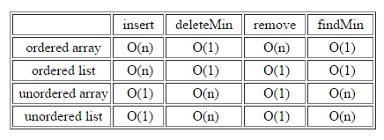

Slide 54
Heap sort Pseudocode
HeapSort(A)
BuildMaxHeap(A)
for i = length[A] downto 2
do swap A[1] with A[i]
heap-size[A] = heap-size[A] – 1
MaxHeapify(A, 1)
end func

Slide 55
MaxHeapify(A, i)
l = left(i)
r = right(i)
if l <= heap-size[A] and A[l] > A[i]
then largest = l
else largest = i
if r <= heap-size[A] and A[r] > A[largest]
then largest = r
if largest != i
then swap A[i] with A[largest]
MaxHeapify(A, largest)
end func
BuildMaxHeap(A)
heap-size[A] = length[A]
for i = |length[A]/2| downto 1
do MaxHeapify(A, i)
end func

